Slide 1
Original Town Zoning Changes - DRAFT

Slide 2
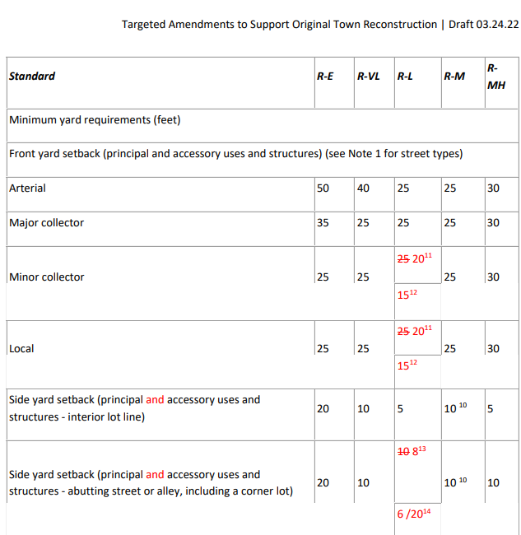
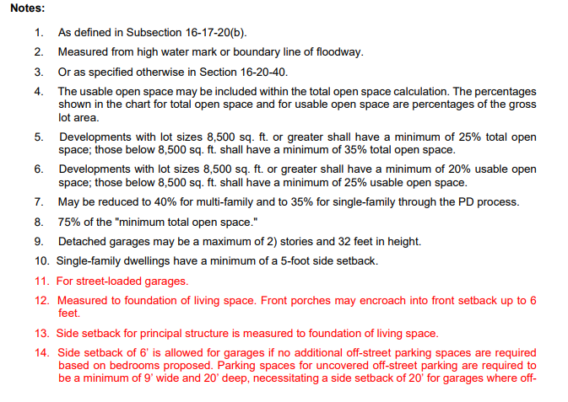
Original Town Zoning Changes - DRAFT
Zoning Changes to apply to all SF homes in both RL and RM zone districts

Slide 3
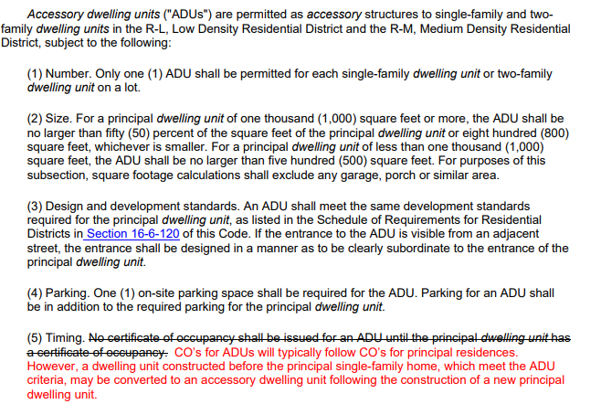
Original Town Zoning Changes - DRAFT

Slide 4
Sagamore Zoning Changes - DRAFT
Sagamore residents looking for flexibility on:
Height
Setbacks – likely limited to front and will require comparable differentiation between garage and living areas as Original Town
Arch. flexibility
Survey follow-up expected to hone in on Arch. needs
3 groups of needs currently known
Those who want/need to rebuild KB floor plans they had
Those who plan to work with production home builder (Remington or Boulder Creek Neighborhoods)
Those who want custom or semi-custom home design

Slide 5
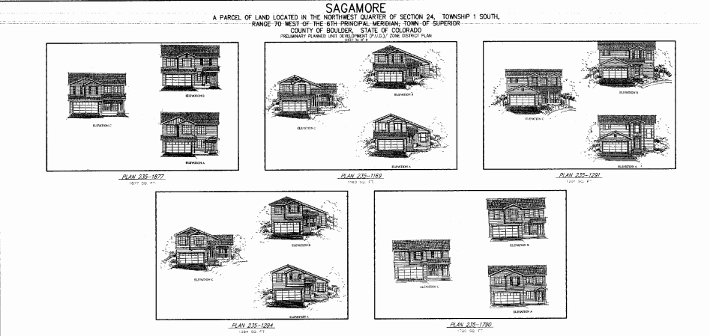
Sagamore Zoning Change - DRAFT

Slide 6
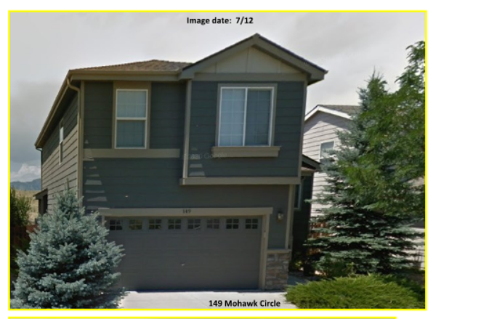
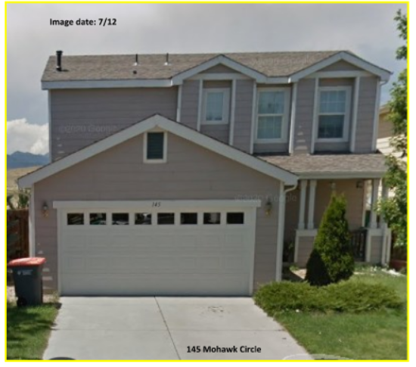
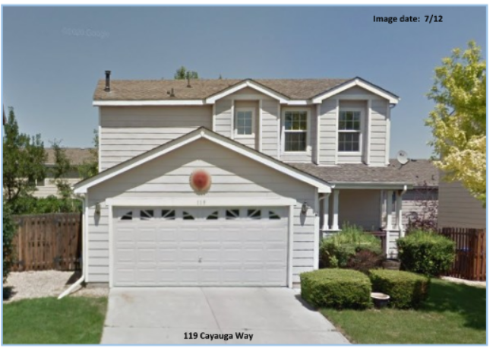
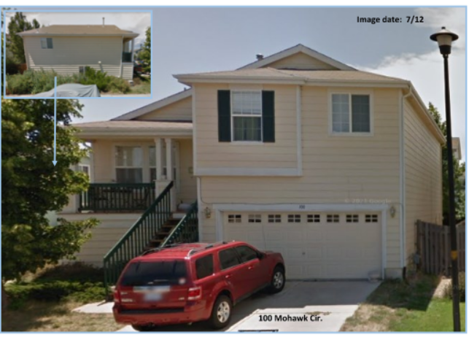
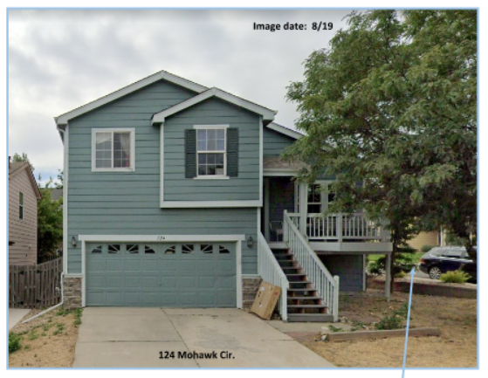
Sagamore Zoning Changes - DRAFT

Slide 7
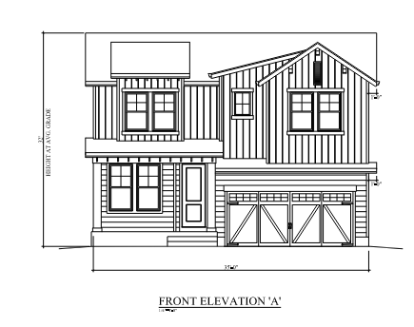
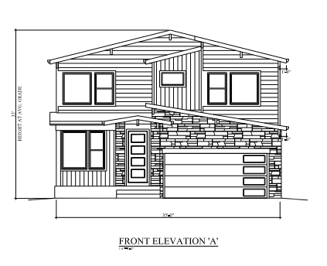
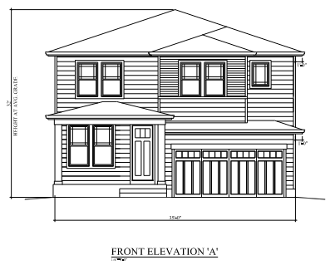
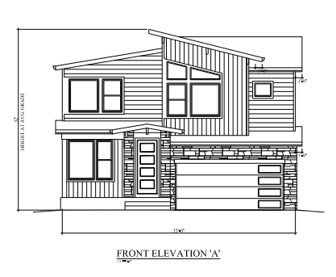
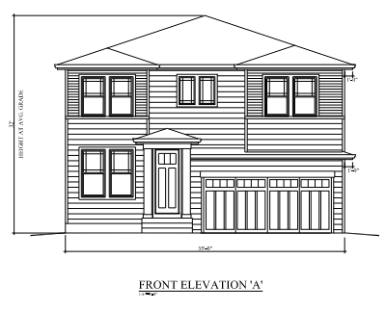
Sagamore Zoning Changes - DRAFT

