Slide 1
OIL AND GAS DEVELOPMENT in the Town of Superior?
November 12, 2018

Slide 2
Outline of presentation
Oil and gas development impacts
State permitting
What we know about proposed development in Superior
Your questions
Potential next steps

Slide 3
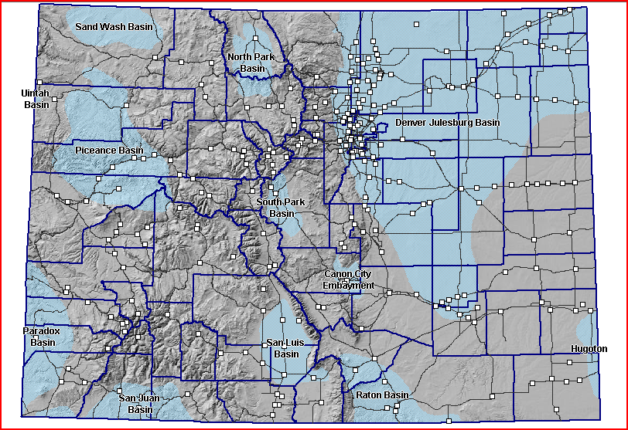
Colorado’s Oil and Gas Basins

Slide 4
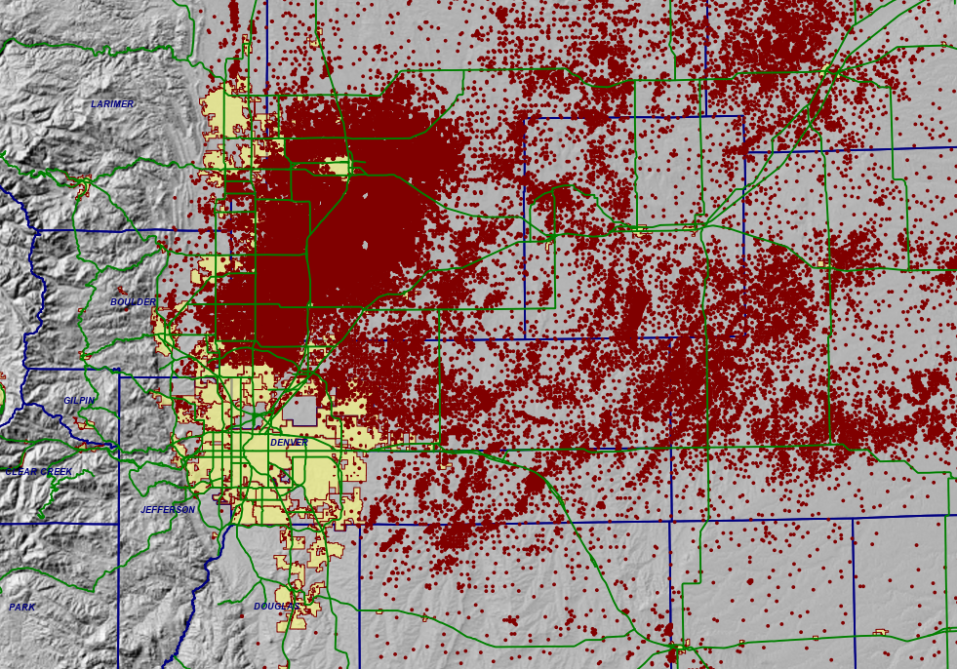

Slide 5
Oil and gas development is a highly-industrialized activity that is primarily regulated by the state

Slide 6
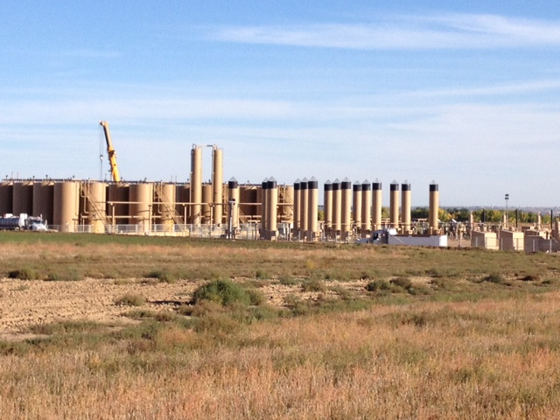

Slide 7
ENVIRONMENTAL AND COMMUNITY IMPACTS OF OIL AND GAS DEVELOPMENT NOISE WATER AIR PUBLIC HEALTH SAFETY

Slide 8
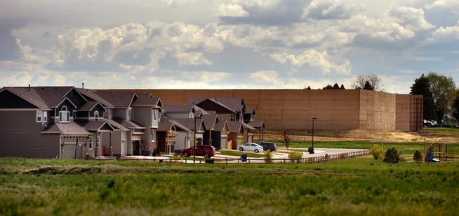
Sound wall near residential area

Slide 9
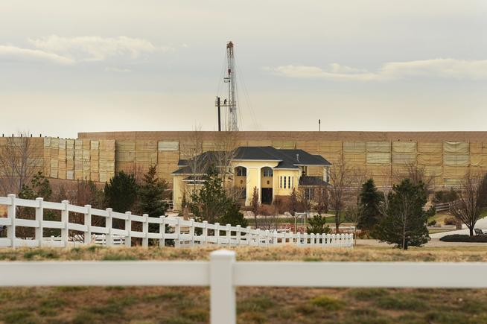

Slide 10
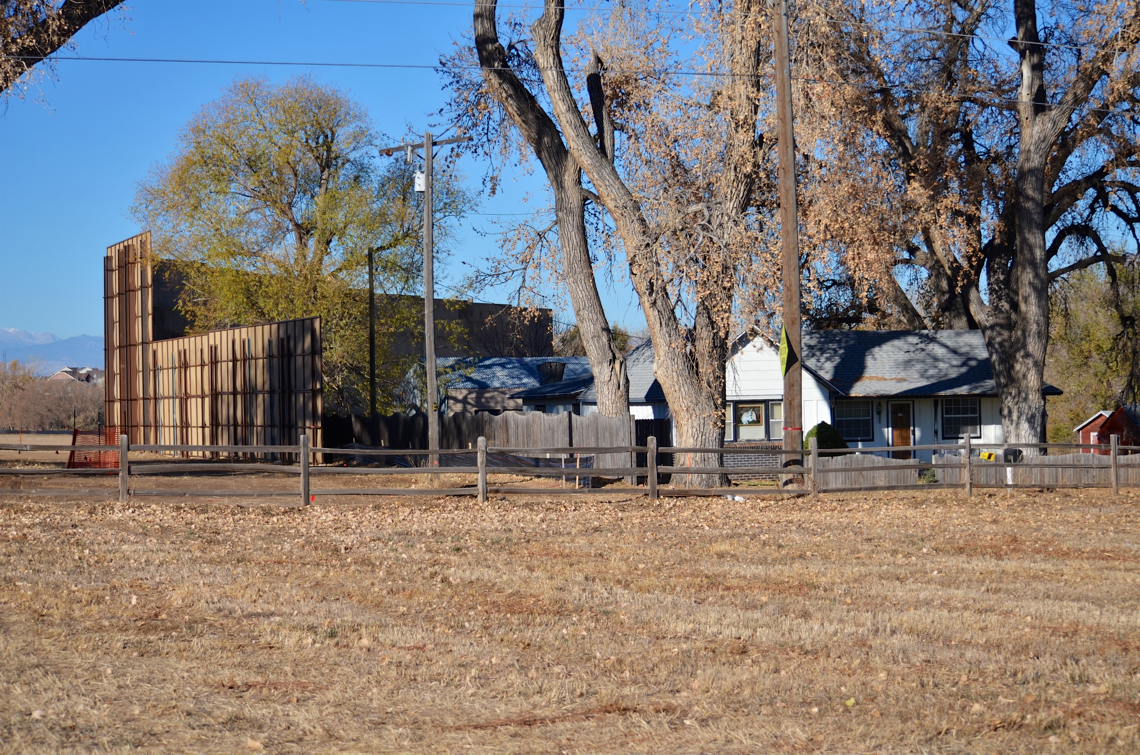

Slide 11
Water Quality

Slide 12
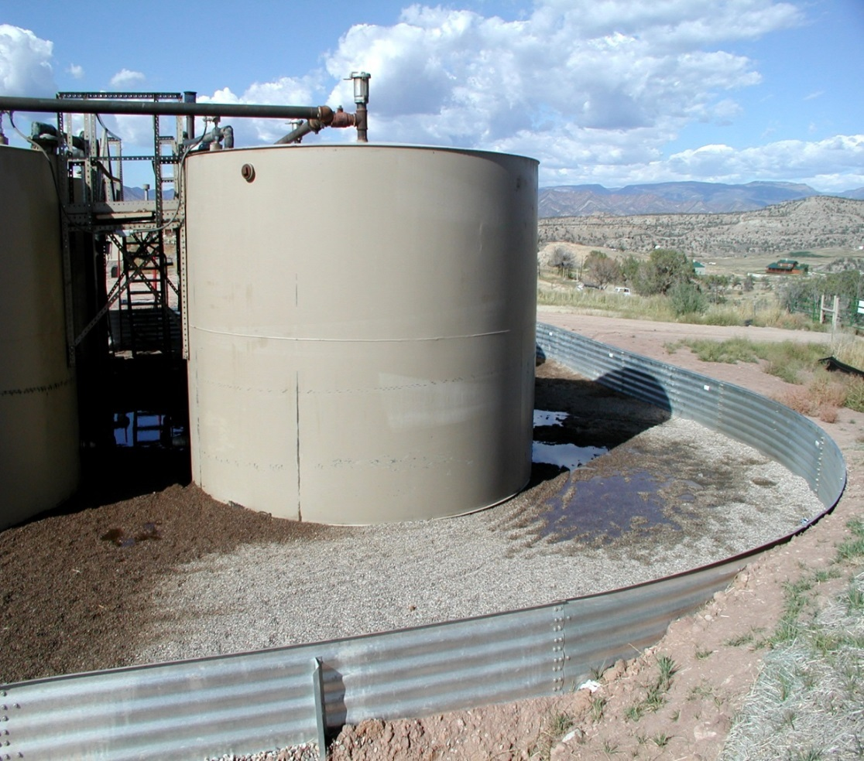
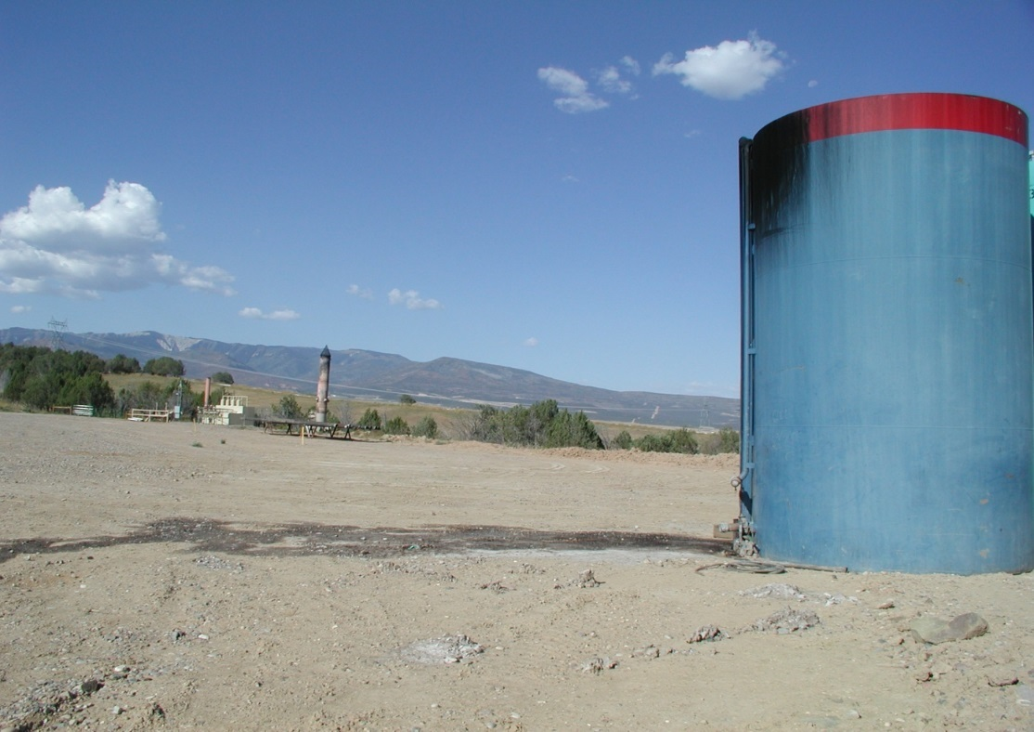
SPILLS
From 2013-2016, there was an average of 1.8 spills per day, with an average size of 171 gallons of oil & 1265 gallons of produced water per spill
Notes:
Three weeks ago Anadarko Petroleum Corporation oil well that blew out of control northeast of Denver near Hudson, forcing closure of Weld County roads for two days, sprayed at least 28,000 gallons of oil, gas and drilling waste water onto surrounding land before fluids were re-directed into tanks
Oil and gas companies operating in Colorado reported 615 spills in 2015, about 15 percent of them affecting groundwater.

Slide 13
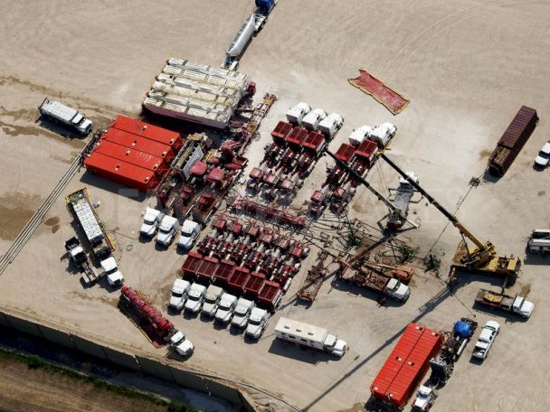
Hydraulic Fracturing

Slide 14
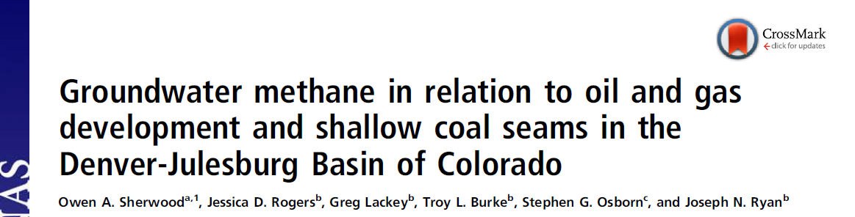
Of 924 sampled water wells in the basin, dissolved methane was detected in 593 wells at depths of 20–190 m.
A total of 42 water wells contained thermogenic stray gas originating from underlying oil and gas producing formations.
The rate of oil and gas wellbore failure was estimated as 0.06% to 0.15% and has remained steady at about two cases per year since 2001.

Slide 15
Inadequate surface casing and leaks in production casing and wellhead seals in older, vertical oil and gas wells were identified as stray gas migration pathways.
These results show that wellbore barrier failure, not high-volume hydraulic fracturing in horizontal wells, is the main cause of thermogenic stray gas migration in this oil- and gas-producing basin.

Slide 16

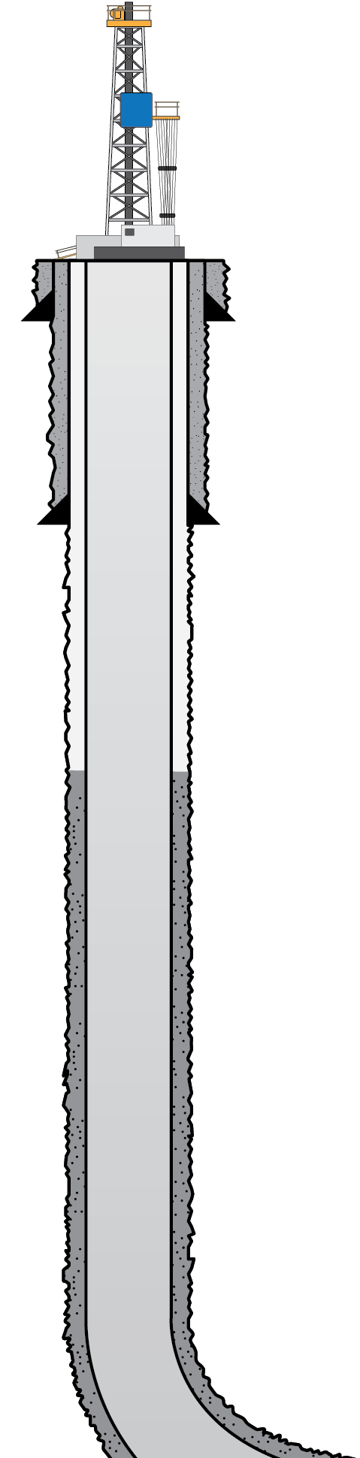
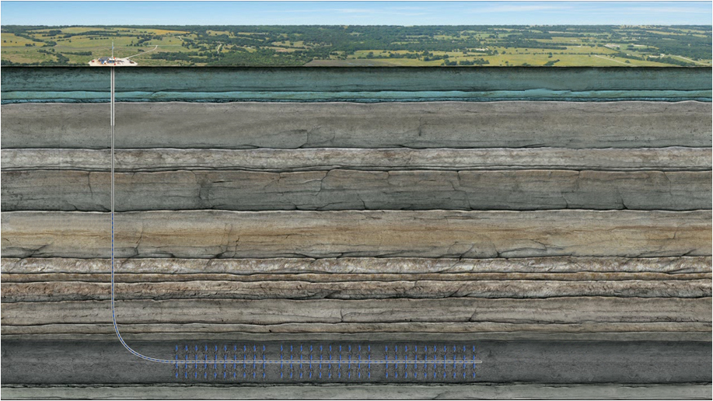


WELL CONSTRUCTION STANDARDS
CONDUCTOR PIPE
CEMENT
FRESH WATER AQUIFER ZONE
SURFACE CASING
CEMENT
400’ Usable Fresh Water
PRODUCTION CASING
Surface Casing 550’
2100’ Various Atoka
Sands & Shales
4000’
of Sediment
SHALLOW PRODUCING ZONE
1300’ Upper Hale
CEMENT
600’ Morrow Shale
300’ Fayetteville Shale
Hindsville
Cross sectional view
TARGET PRODUCING ZONE

Slide 17
GOOD MECHANICAL INTEGRITY
CONDUCTOR PIPE
FRESH WATER AQUIFER ZONE
SURFACE CASING
PRODUCTION CASING
SHALLOW PRODUCING ZONE
TARGET PRODUCING ZONE

Slide 18
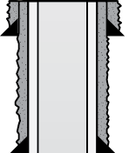
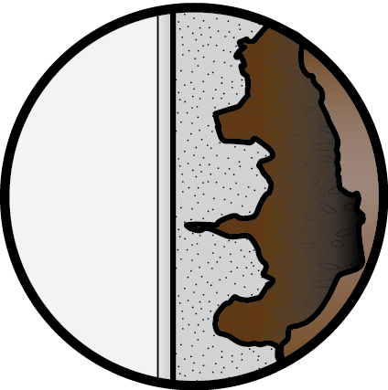
CEMENT CHANNELING
CONDUCTOR PIPE
PRESSURE
BUILDS UP
FRESH WATER AQUIFER ZONE
SURFACE CASING
PRODUCTION CASING
FORMATION
SHALLOW PRODUCING ZONE
CASING
CEMENT
TARGET PRODUCING ZONE

Slide 19

INSUFFICIENT CEMENT COVERAGE
CONDUCTOR PIPE
PRESSURE
BUILDS UP
FRESH WATER AQUIFER ZONE
SURFACE CASING
PRODUCTION CASING
SHALLOW PRODUCING ZONE
TARGET PRODUCING ZONE

Slide 20
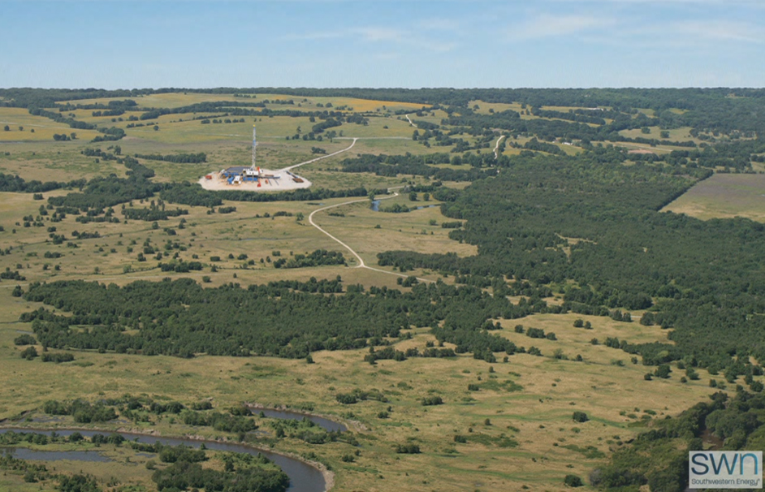
IMPACTS TO AIR QUALITY AND HEALTH
Local
Dust
Toxic emissions
Carcinogenic
(Benzene)
Regional
Front Range in Non-Attainment for Ozone
NW Colorado in Non-Attainment for Ozone.
Global
Methane is 20 X more potent greenhouse gas than CO2

Slide 21
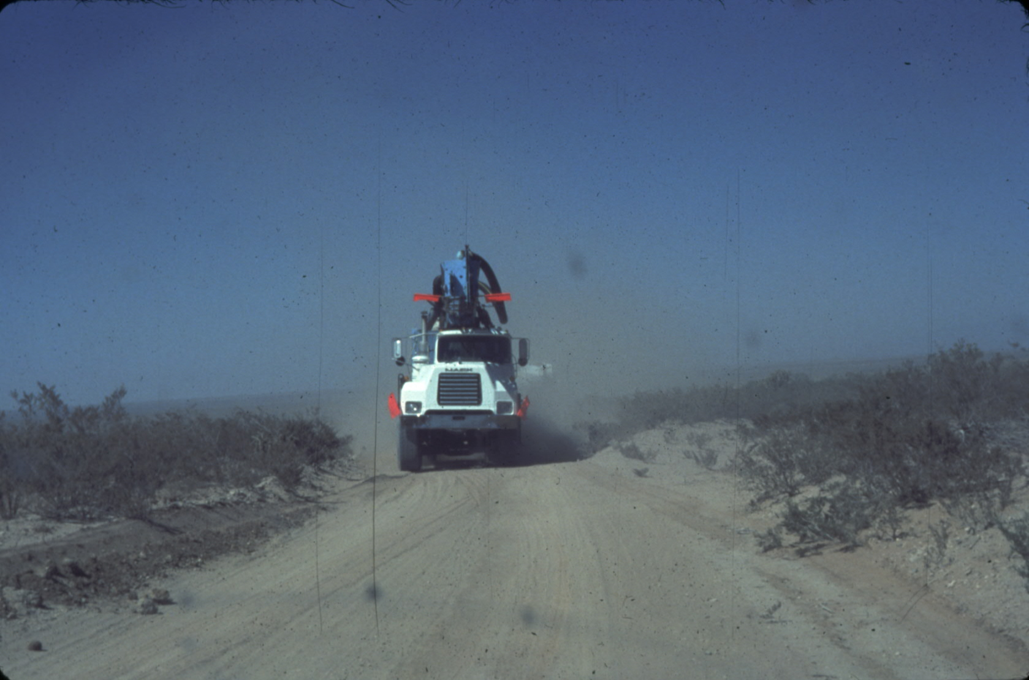
Dust and emissions from
heavy truck traffic

Slide 22
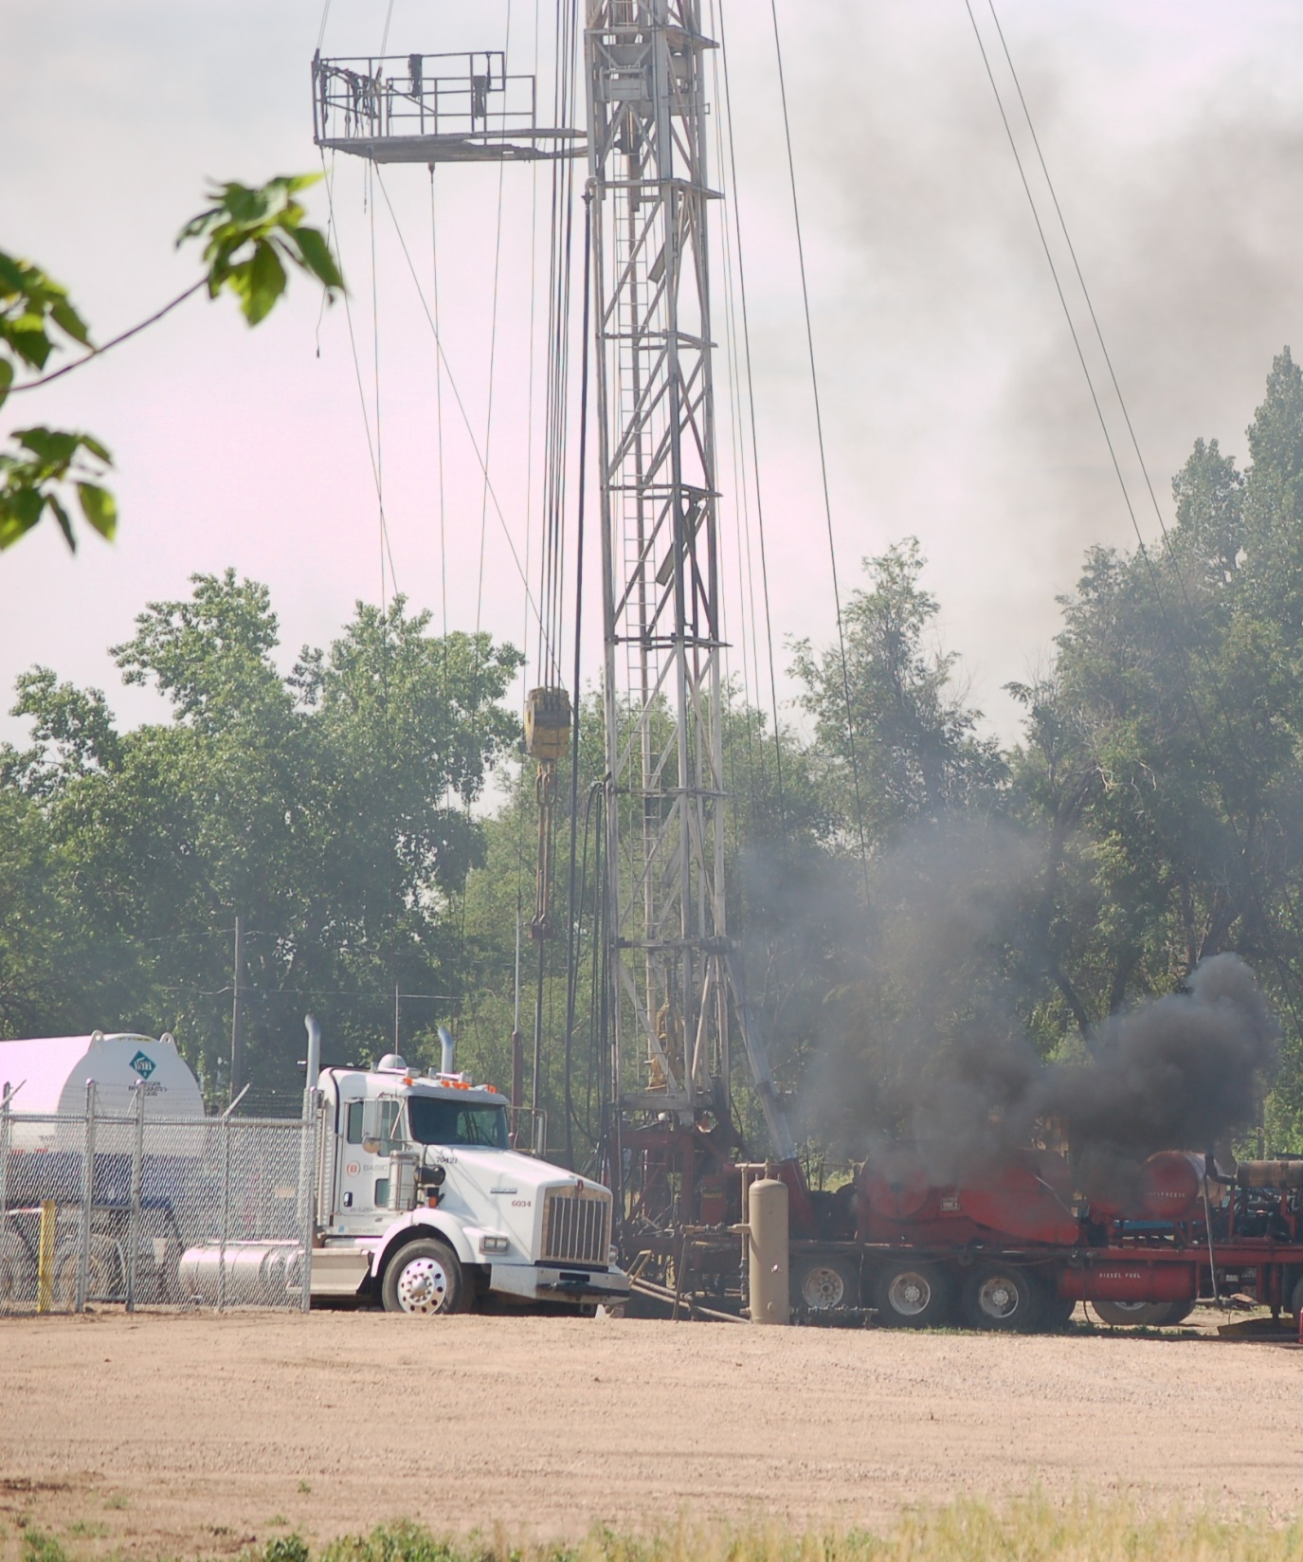

Slide 23
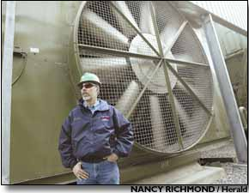
Compressor Engines
Notes:
Compress natural gas for transmission, storage, processing
Large engines can be upwards of 5,000 horsepower, equivalent to horsepower of 20 standard Dodge Ram pickups
Significant source of nitrogen oxides (NOx), carbon monoxide (CO), VOCs, including formaldehyde
800 existing compressor engines in western Colorado that are at least 500hp
According to CDPHE, one 2000hp
compressor station in Rio Blanco
County is permitted to emit:
341.6 tons of NOx a year → equivalent to NOx released by 17,884 cars each driven 12,500 miles a year
10.75 tons of VOCs a year → equivalent to VOCs released by 278 cars each driven 12,500 miles a year
48.075 tons of CO a year: CO at any level is toxic

Slide 24
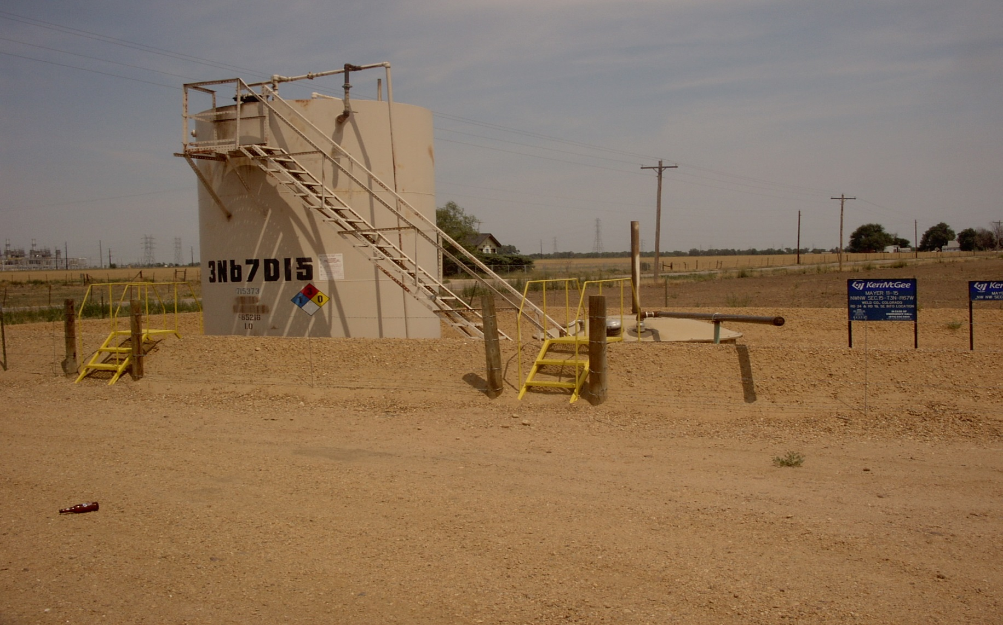
Storage Tanks
Notes:
Located at producing wells, compressor stations, and processing plants
Pollution from “flashing,” or evaporation of condensate.
VOCs released include formaldehyde, benzene, other toxic air pollutants

Slide 25
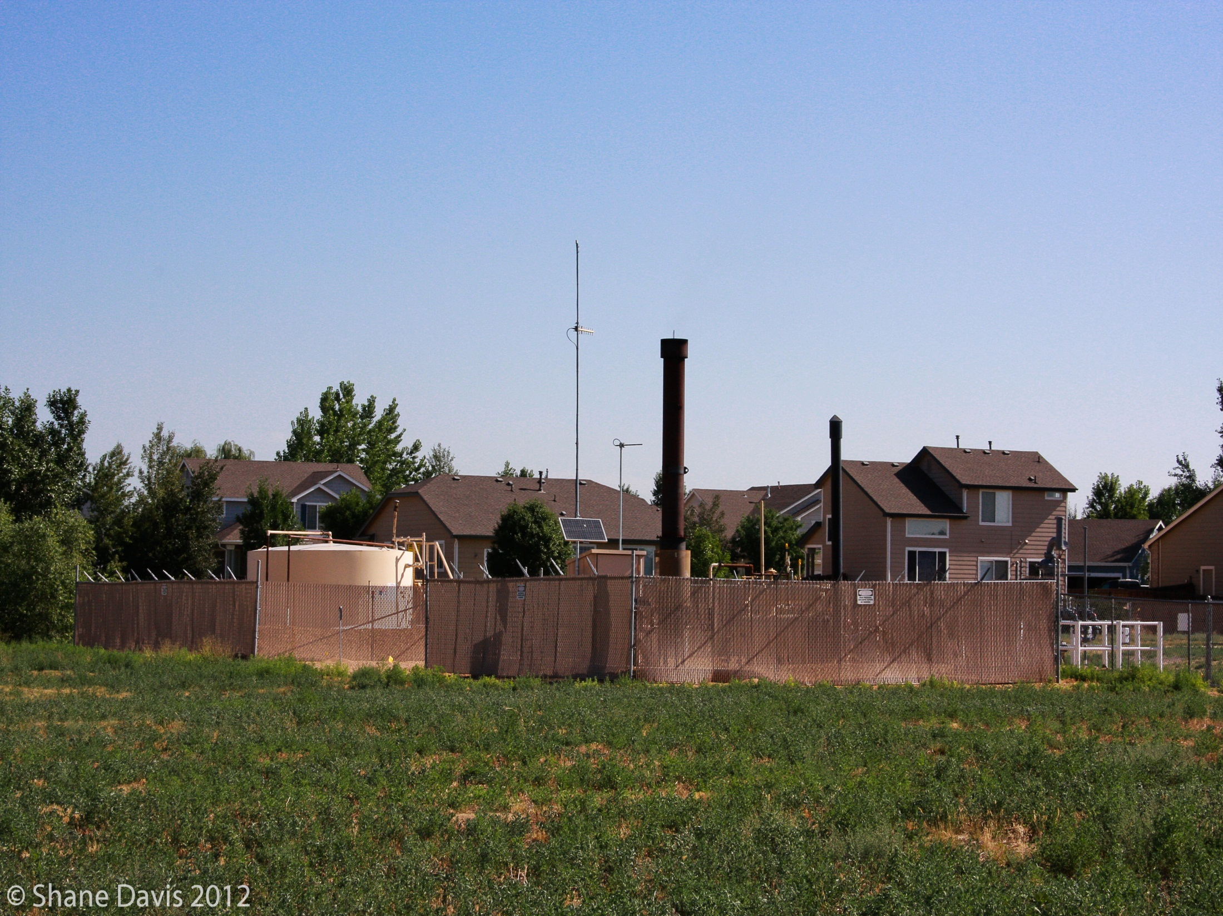

Slide 26
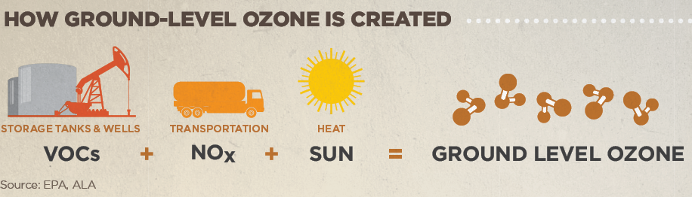
Ground-Level Ozone

Slide 27
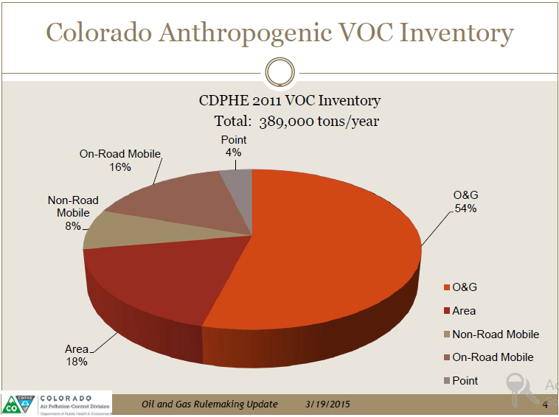

Slide 28
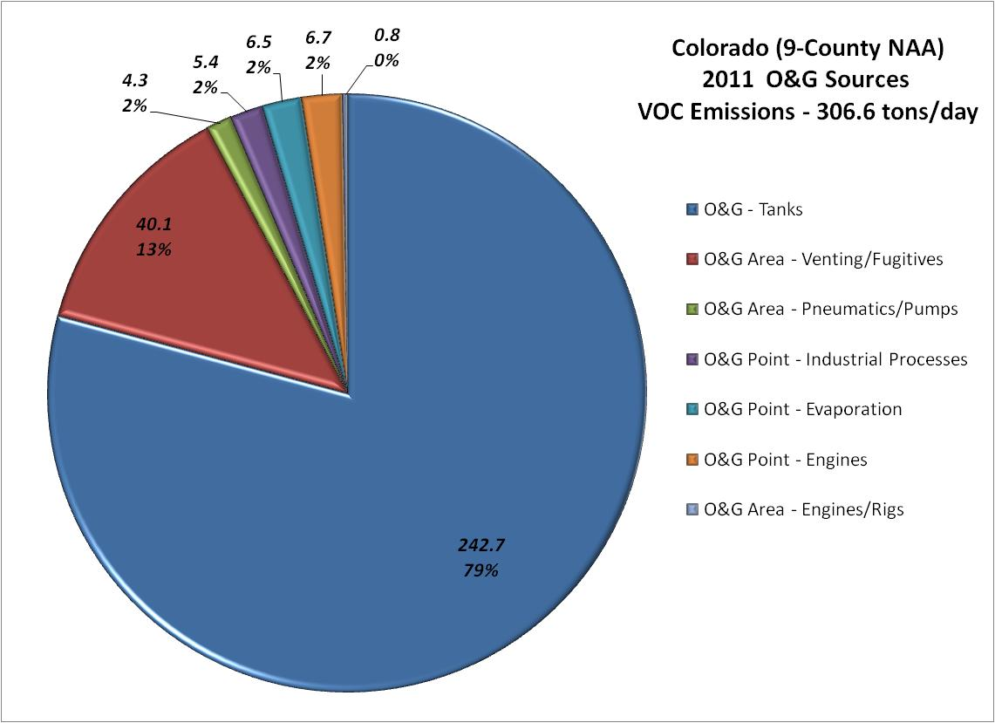

Slide 29
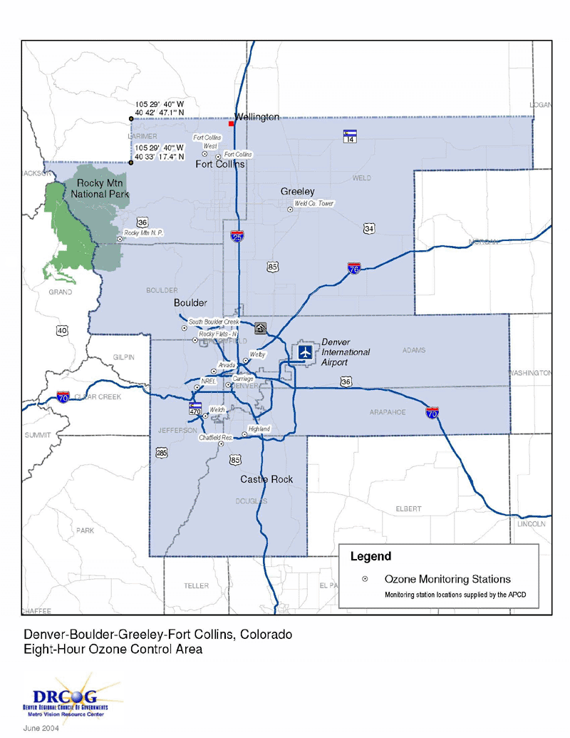

Slide 30
Increased risk to public safety?

Slide 31
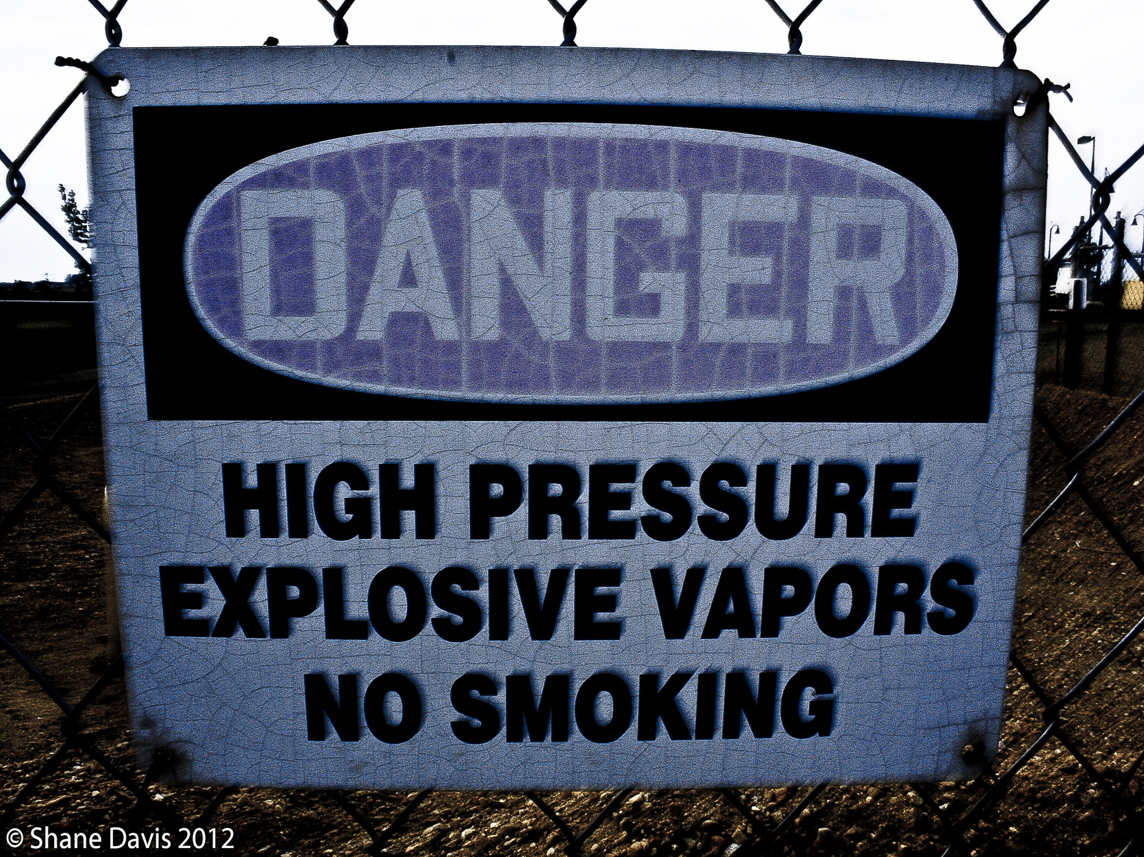

Slide 32
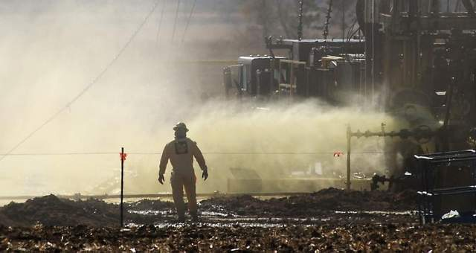
Well blow-out near Windsor, CO in February, 2013. Similar blow-out happened in Hudson, CO in February, 2017

Slide 33
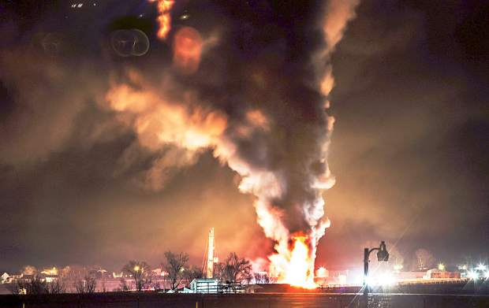
Tank explosion north of Greeley in 2014 There were six tank explosions and fires in two months in 2014. Another tank explosion occurred in Mead just this year.

Slide 34
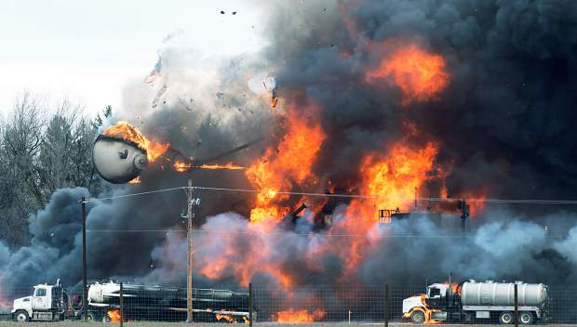
Result of a lightning strike of waste water facility near Greeley on April 17, 2015

Slide 35
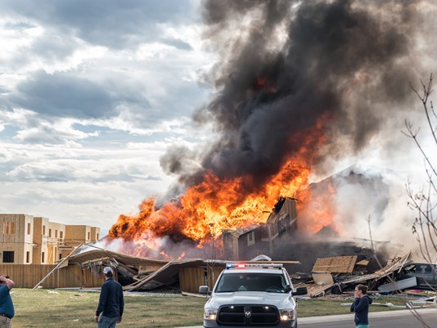
Firestone tragedy
April 17, 2017

Slide 36
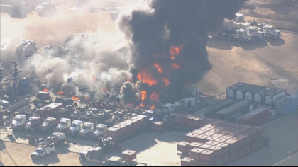
On November 6, 2018 at a Noble Energy well site near Platteville: Liberty Oilfield Services equipment caught fire while performing completion operations on a well

Slide 37
Setbacks- 600 series Rules
Schools and hospitals: 1,000-foot setback
Urban Setbacks: 500-foot setback
Affects less than 4% of wells
Rural Setback: 500-foot setback
Allows an “exception” if the industry asks for it
The only requirement is that impacts are mitigated to the greatest extent economically practicable

Slide 38
2. Superior’s authority to regulate
Land Use Authority
Colorado Revised Statutes § 29–20–104 (“Land Use Enabling Act”)
General police powers
C.R.S. § 31-15-401.
In relation to the general police power, the governing bodies of municipalities have the following powers:
(c) To declare what is a nuisance and abate the same and to impose fines upon parties who may create or continue nuisances or suffer nuisances to exist; ** Frederick case cited by industry did not exert its authority under general police powers

Slide 39
2. Superior’s authority to regulate
Air Quality Regulations
§ 25-7-128. Local government--authority--penalty
(1) Home rule cities, cities, towns, counties, and cities and counties are hereby authorized to enact local air pollution resolutions or ordinances. Every such resolution or ordinance shall provide for hearings, judicial review, and injunctions consistent with sections 25-7-118 to 25-7-121 and shall include emission control regulations which are at least the same as, or may be more restrictive than, the emission control regulations adopted pursuant to this article;

Slide 40
PREEMPTION
Municipal regulations may not be in operational conflict with the COGCC regulations.
Operational conflict means: “materially impede or destroy the state interest” in oil and gas development.
Voss v. Lundvall Bros., Inc., 830 P.2d 1061, 1066 (Colo. 1992).

Slide 41
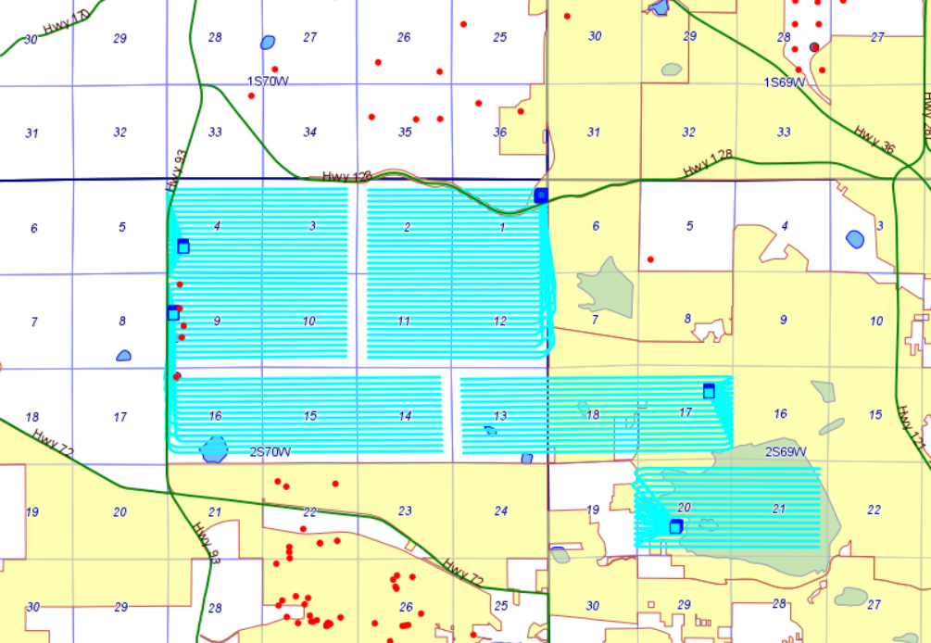

Slide 42
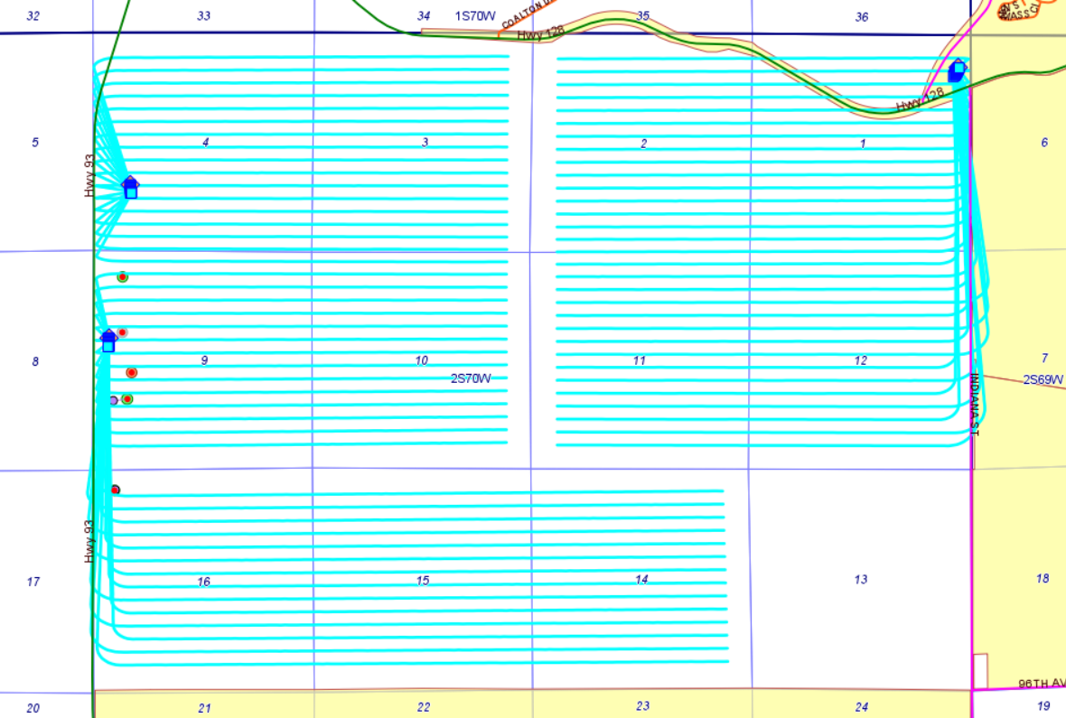

Slide 43
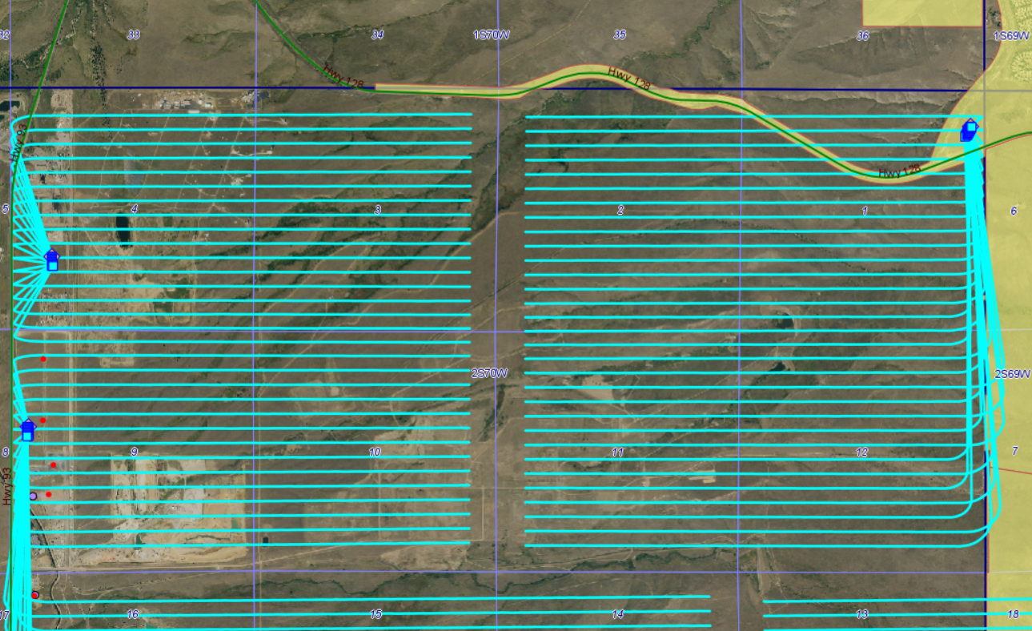

Slide 44
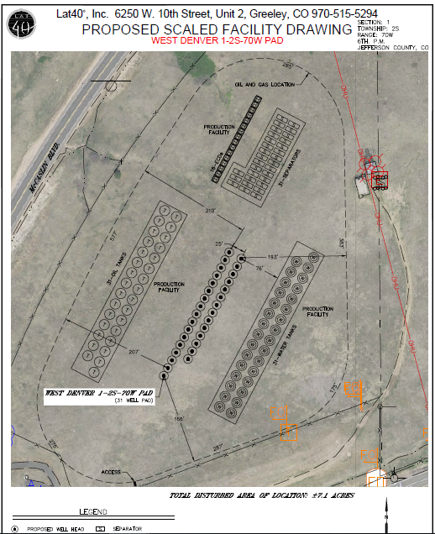
31 wells
62 tanks
31separators
16 emission control units

Slide 45
Typical process for state approval
Drilling and spacing unit approved
Form 2A (Location Assessment) and Form 2 (Application for Permit to Drill)
20 days for public comment
LGD can require 10 additional days public comment
LGD can require CDPHE consultation 20 days public comment
Local government or surface owner can request COGCC hearing on location

Slide 46
Superior Code
Allows oil and gas drilling accessory equipment and storage tanks in agricultural and open space districts through Special Review
(1) Materially endanger the public health or safety;
(2) Substantially injure the value of adjoining or abutting property;
(3) Be in harmony with the area in which it is to be located;
(4) Impact surrounding properties or the Town in general in ways that are not adequately mitigated as proposed by the applicant;
(5) Result in an adverse environmental impact; or
(6) Be in general conformity with this Chapter, other applicable Town ordinances and the Comprehensive Plan.

Slide 47
Many open questions…
Federal permit required for drilling under superfund site?
Plutonium on property being proposed for oil and gas development?
Landowner (Level 3 Communications) to grant Surface Use Agreement?

